Slide 1
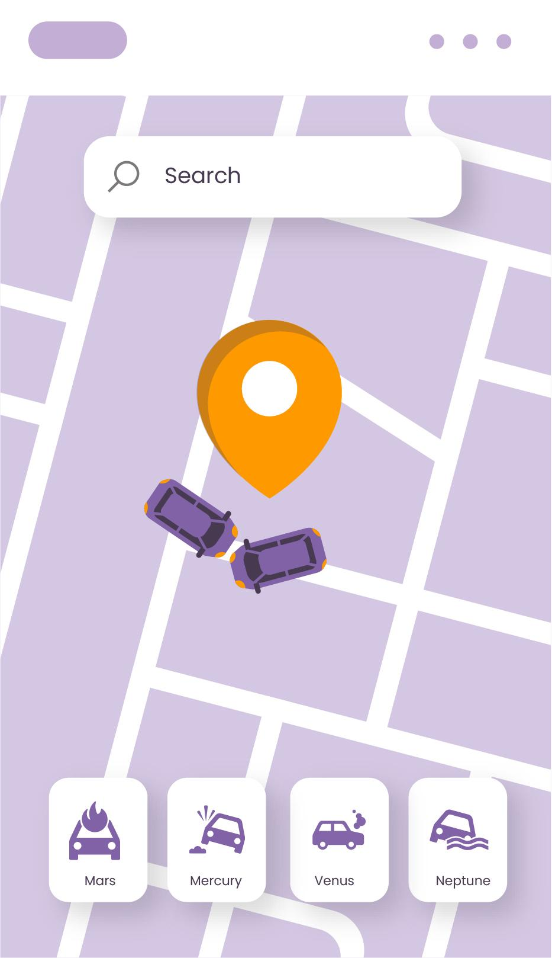
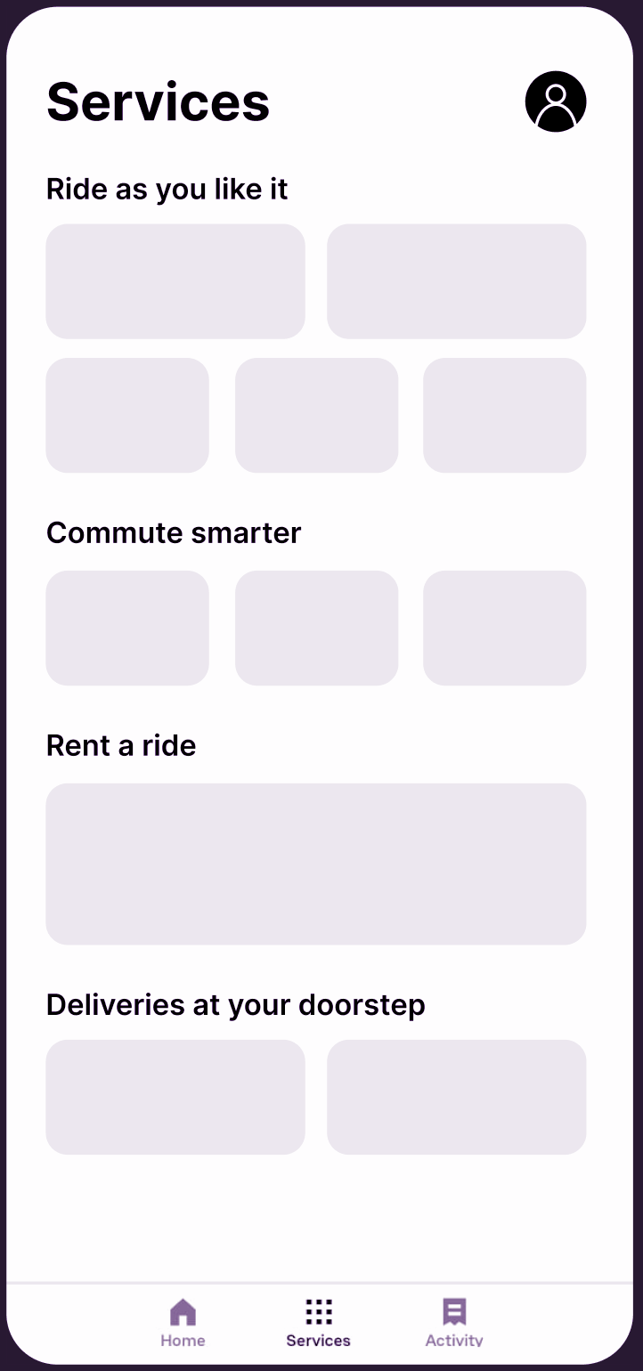
BizWiz
By A_G8_P2
Ashutosh Prasad, Arun Kumar, Bhumik, Dakshant Choudhary, Dhruv Tanwar, Evani Menon

Slide 2
Problem Understanding
Consumers often find it difficult to connect with small businesses and freelancers for any kind of short-term contractual work due to the lack of a centralized platform where businesses can list their services. This leads to a lot of confusion when it comes to hiring professionals, making it difficult to find reliable service-providers. The entire process is quite inefficient and time-consuming. We aim to create a unified platform where businesses and independent freelancers can list their services, improve their visibility and gain access to a wider consumer base.

Slide 3
Motivation
The motivation behind BizWiz stems from the difficulties consumers face when trying to connect with small businesses and freelancers for short-term contractual work. The lack of a centralised platform leads to confusion and inefficiency in the hiring process, making it challenging to find reliable service providers. BizWiz aims to address this problem by creating a unified platform that enhances visibility for businesses and freelancers, providing them with access to a broader consumer base.

Slide 4
Requirement Gathering
We conducted multiple surveys in order to gain insight into the problems that people face when trying to contact small businesses and freelancers and also to understand the expectations and requirements that people might have with the application that want to design.

Slide 5
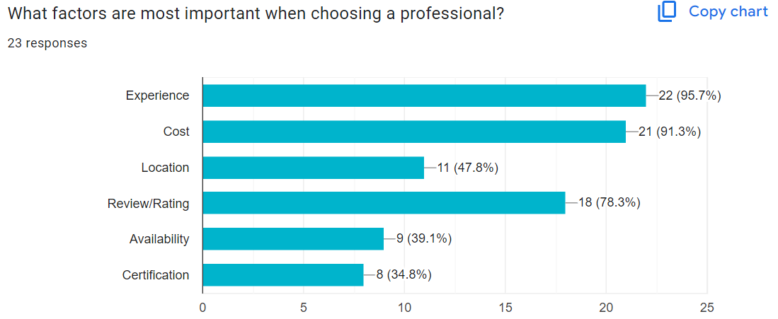
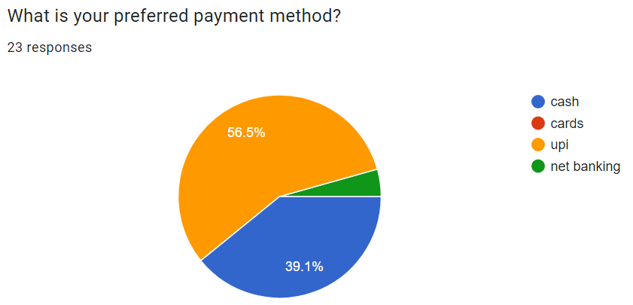
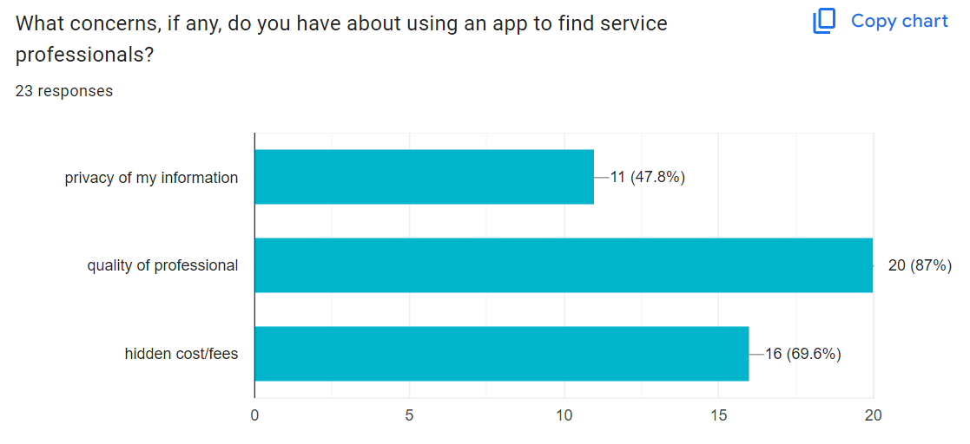
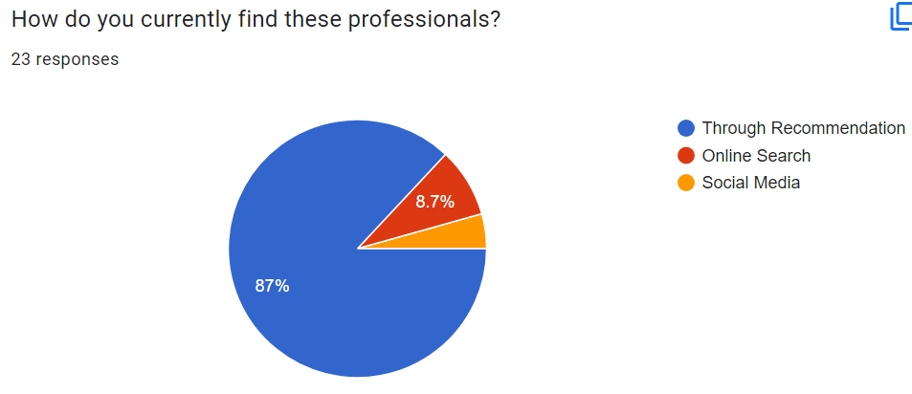
Google Forms (Link)

Slide 6
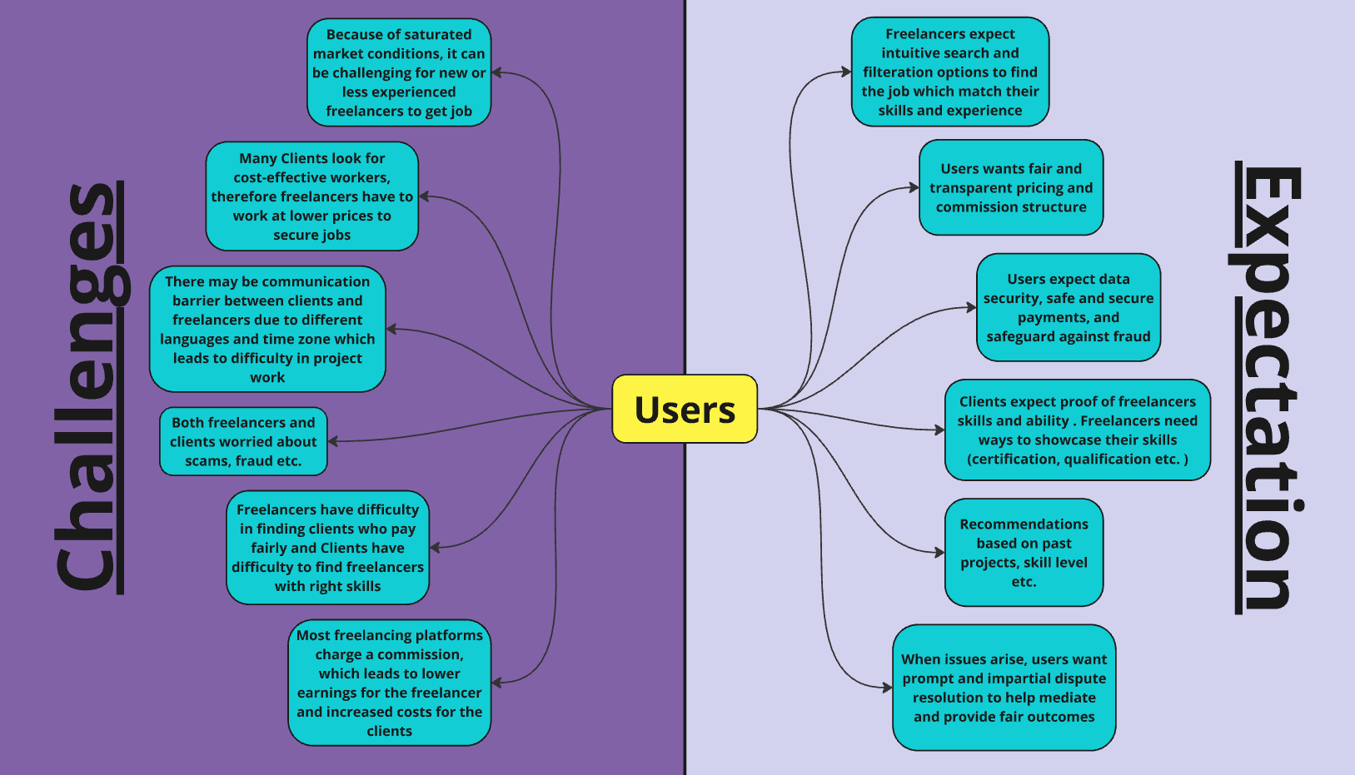

Slide 7



Personas & Scenarios

Slide 8
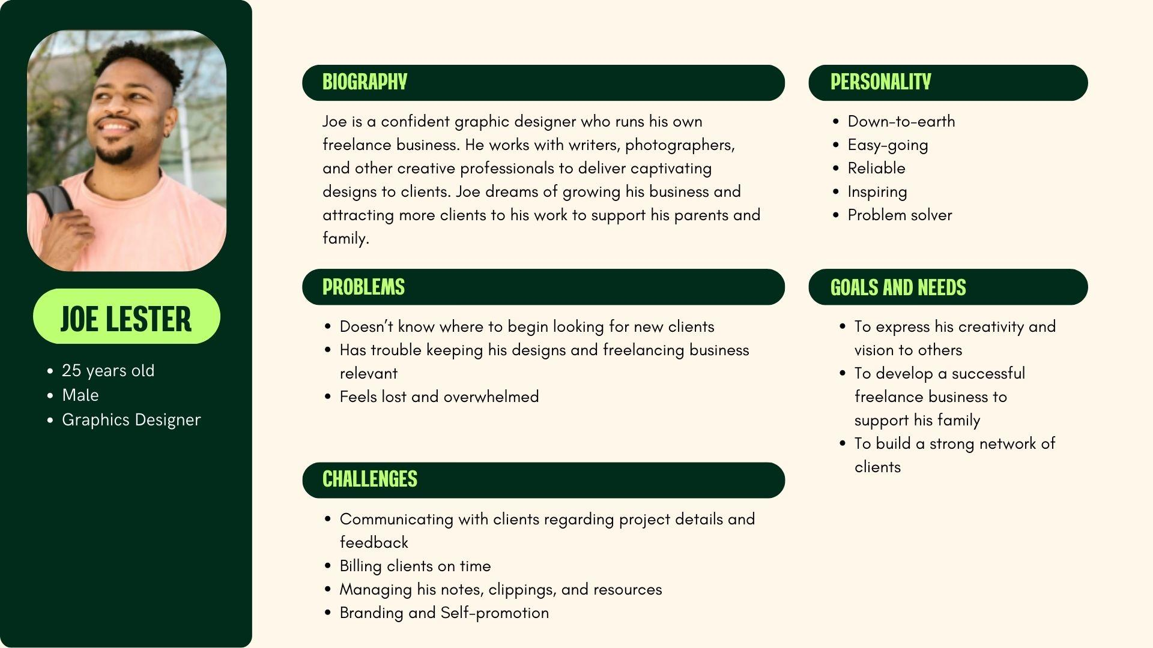

Slide 9
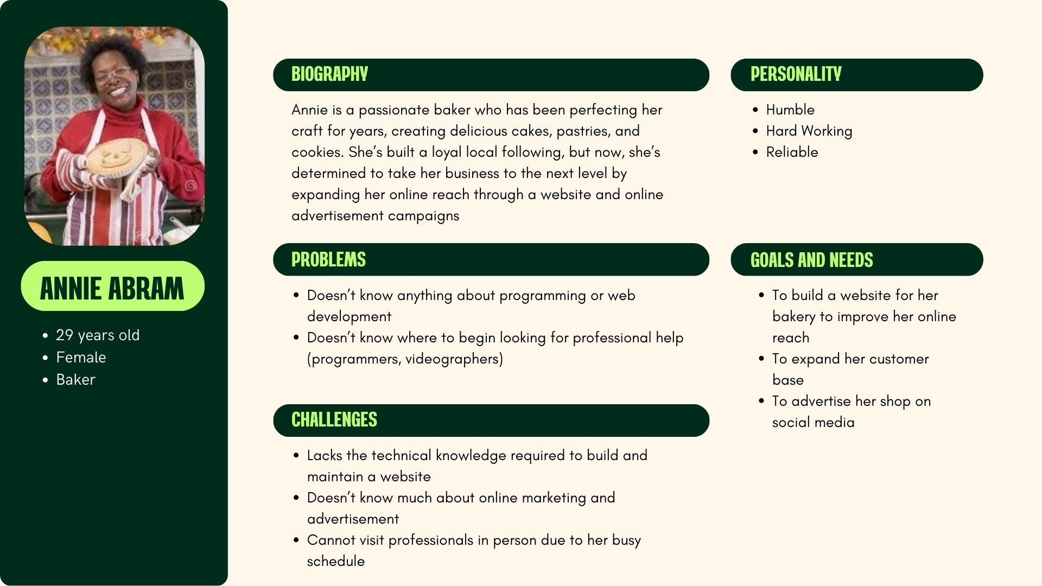

Slide 10
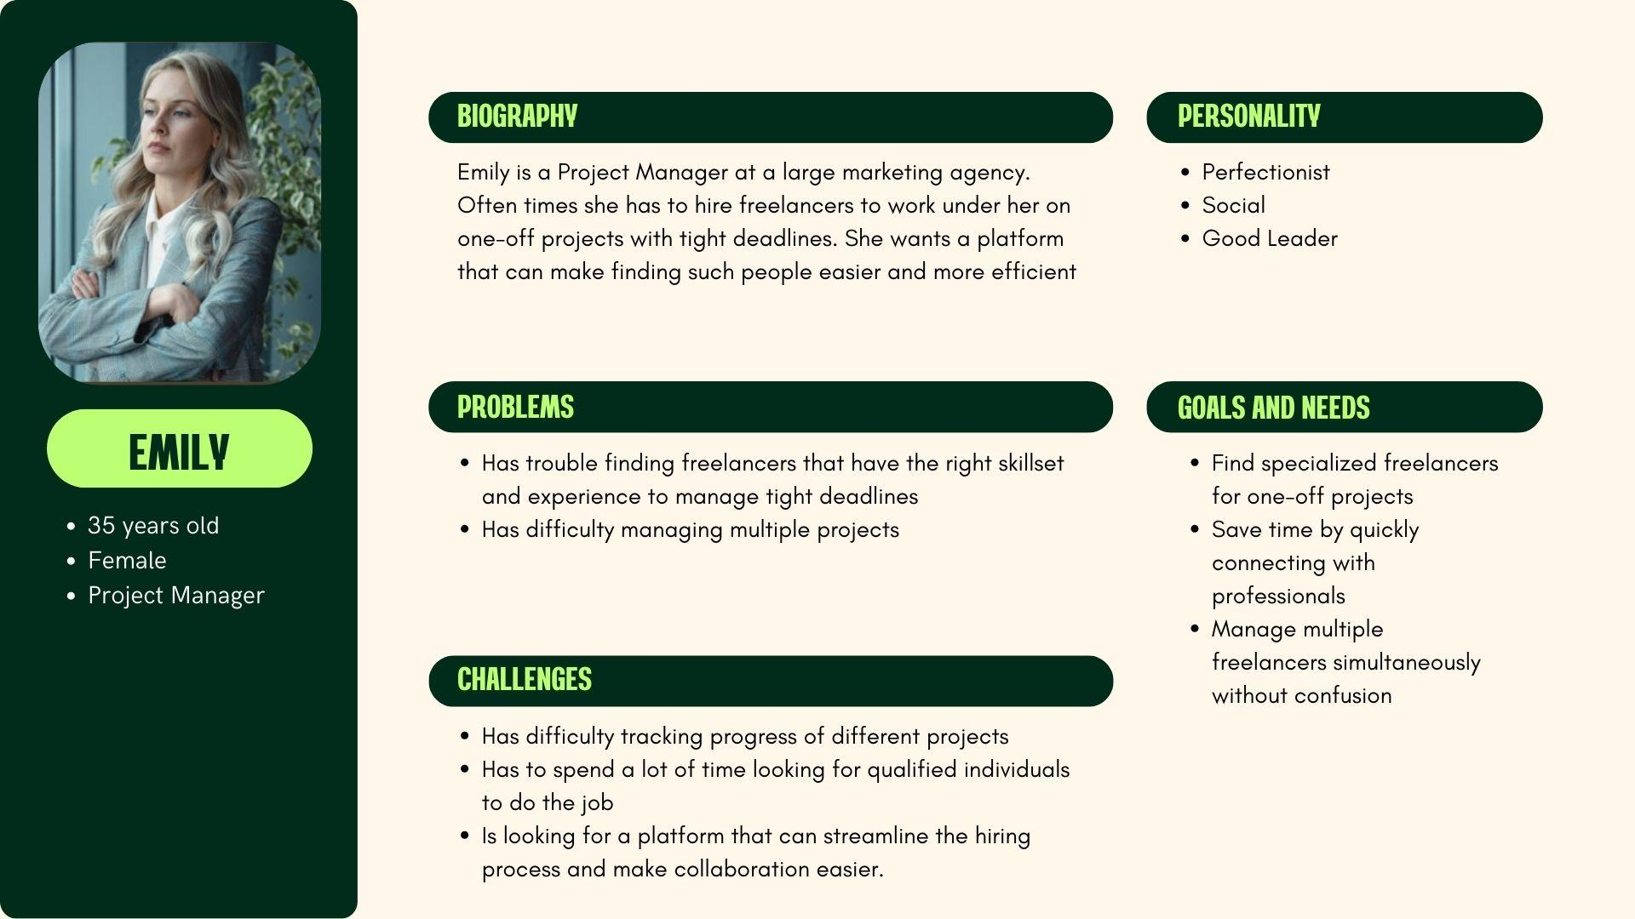

Slide 11
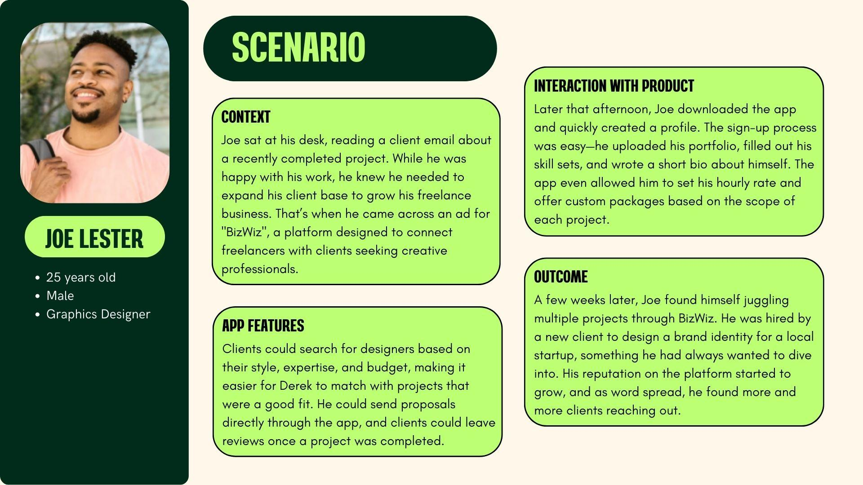

Slide 12
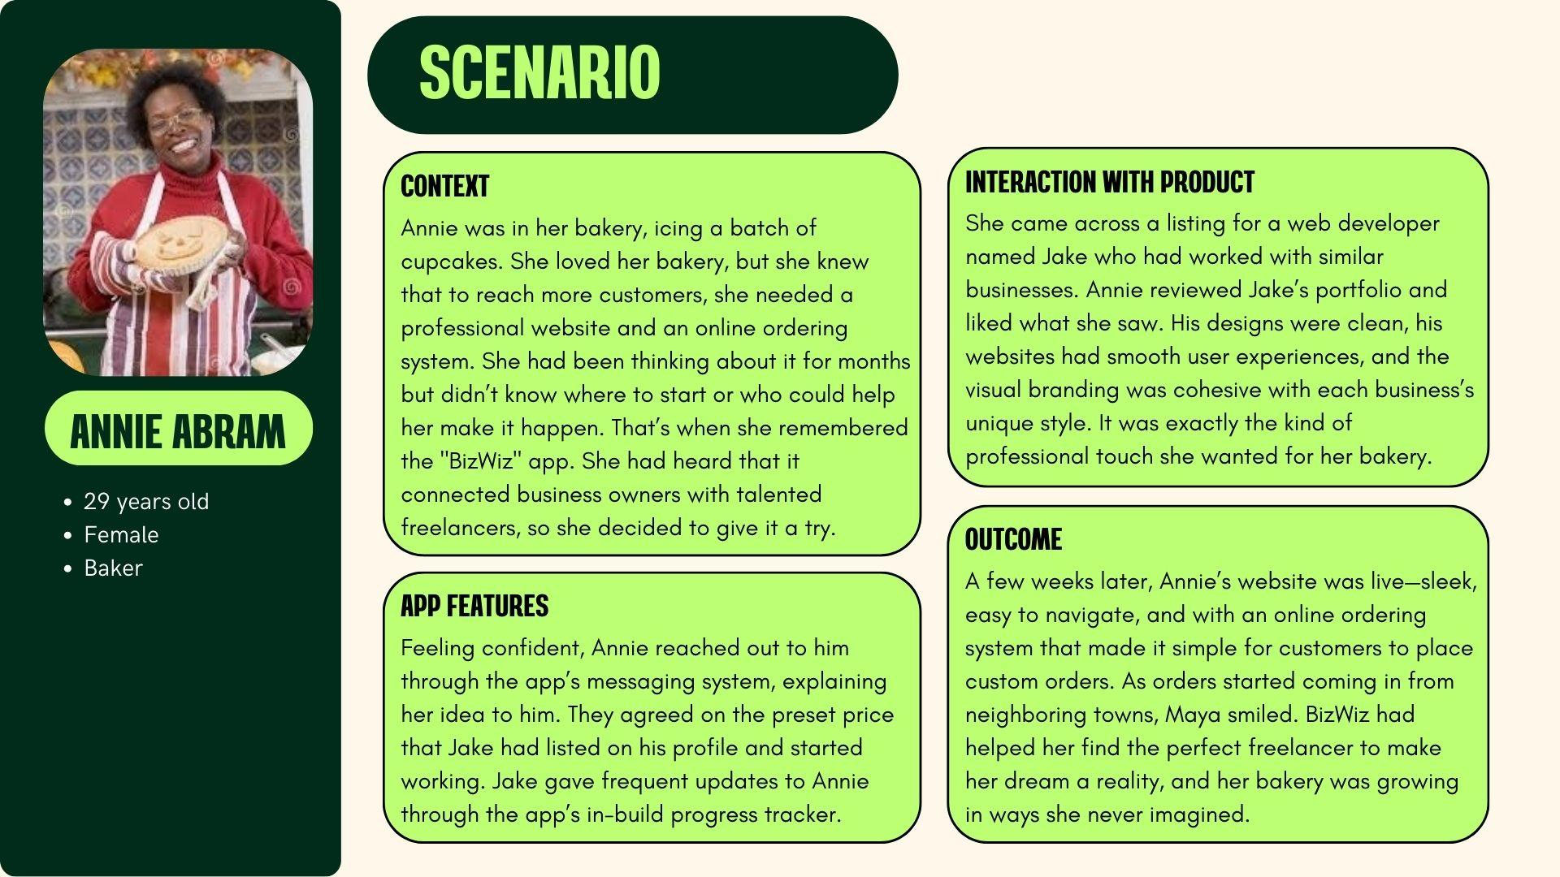

Slide 13
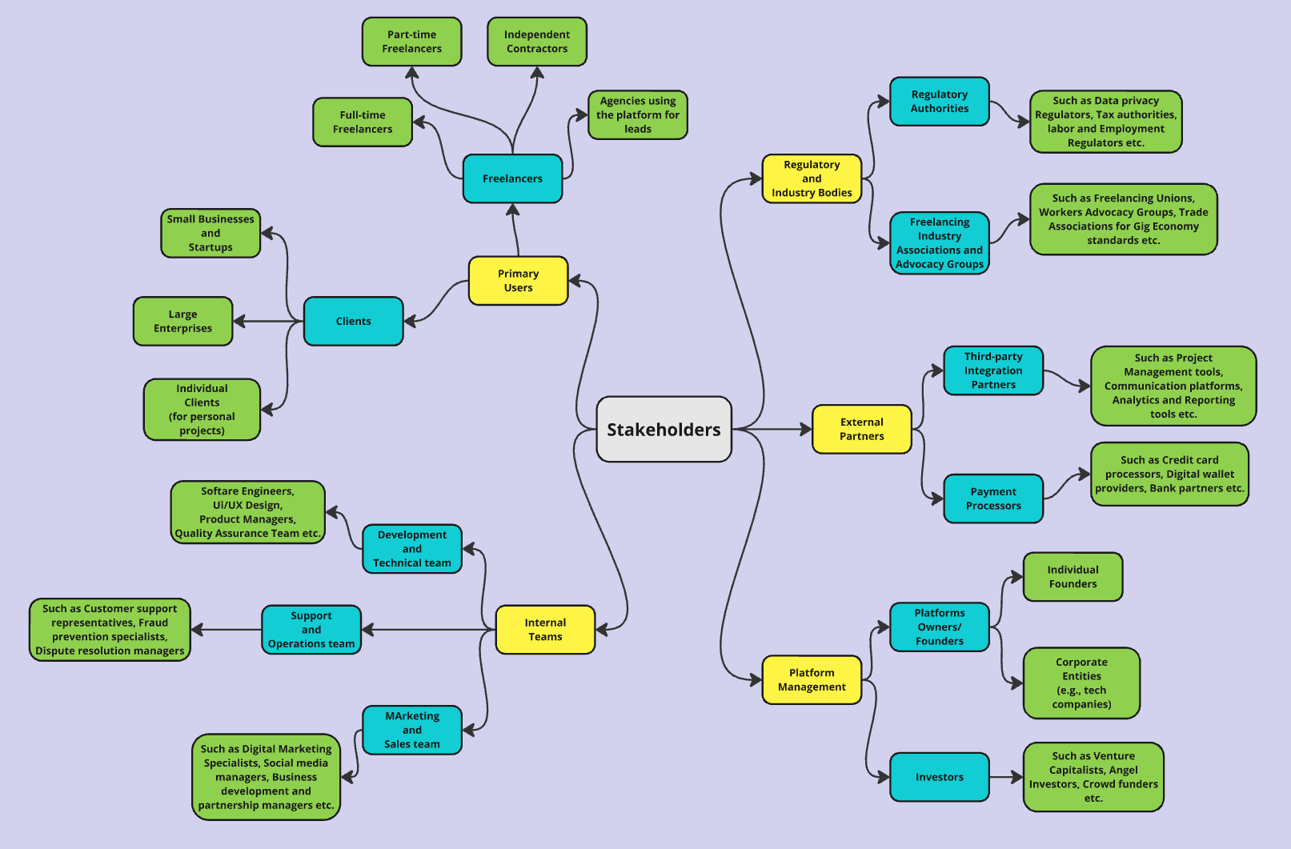
Stakeholders
(Link)

Slide 14
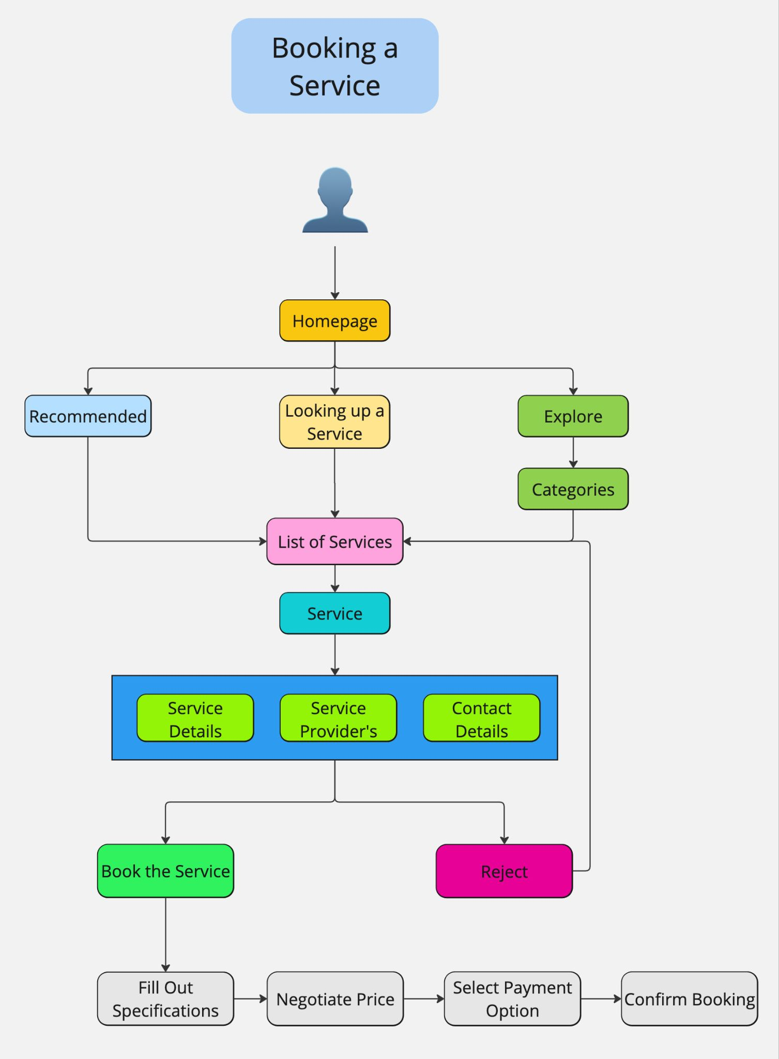
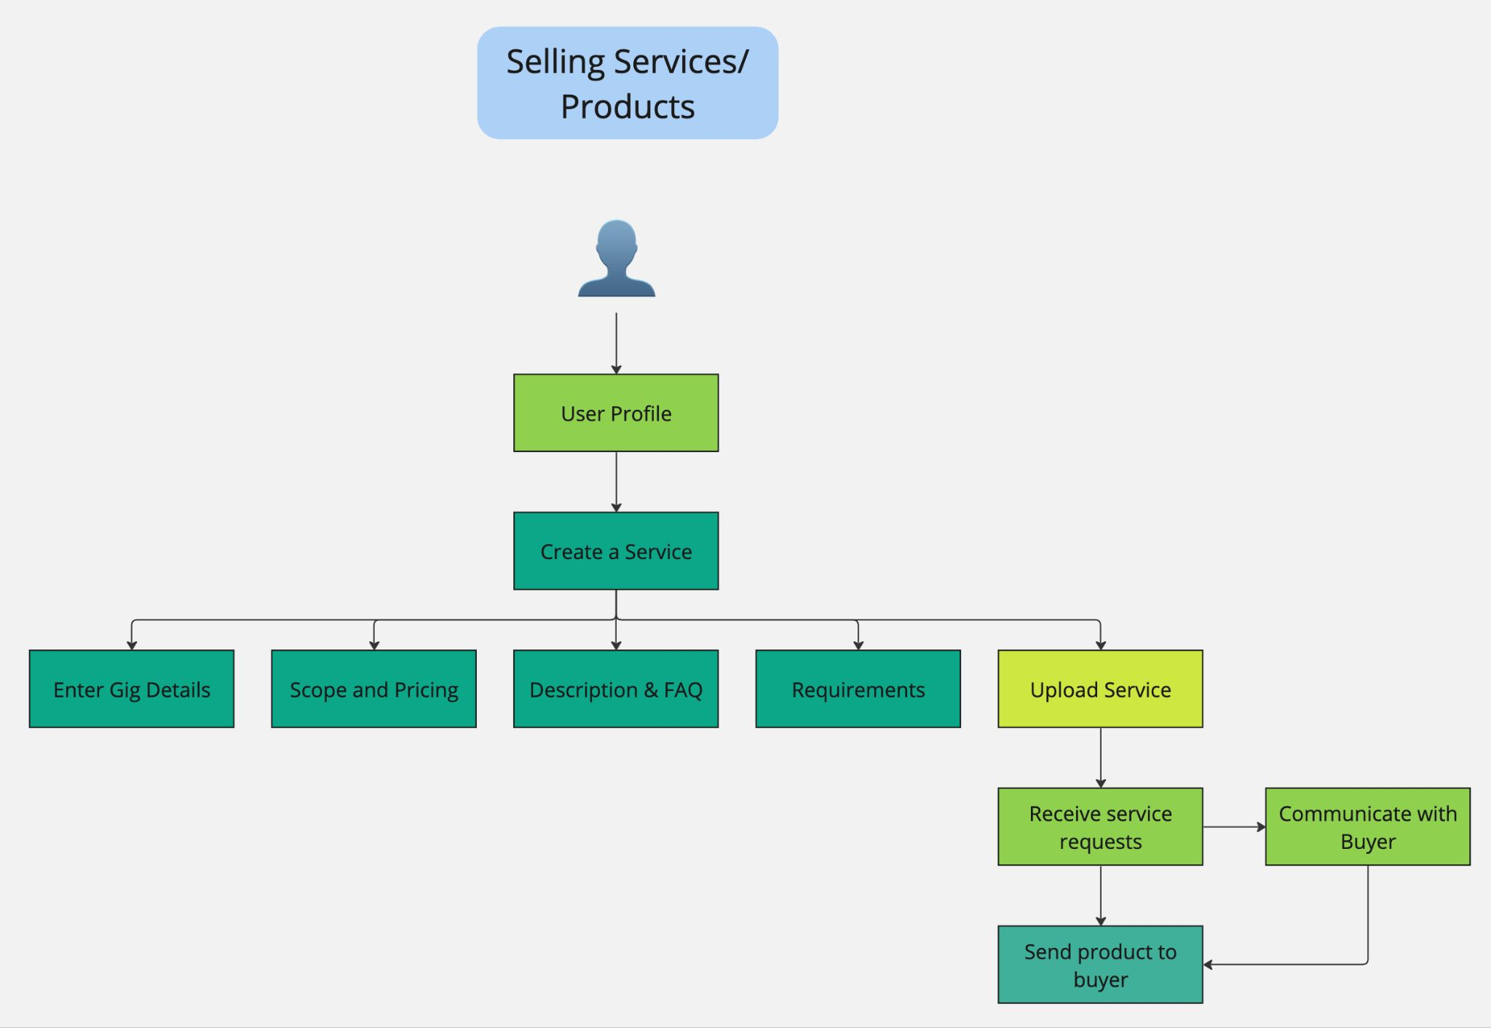
Task Flows (Link)

Slide 15
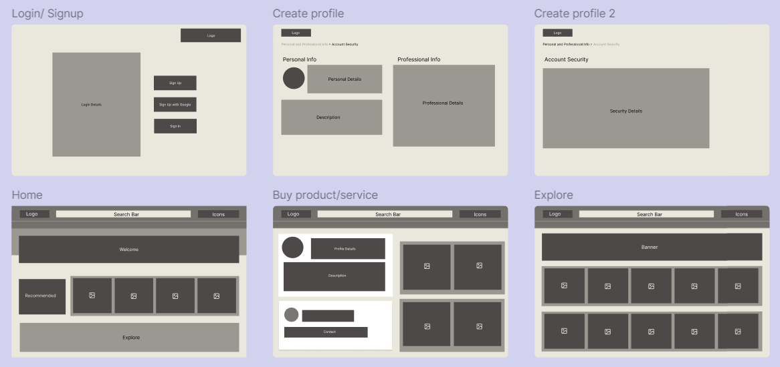
Lo-Fi Designs (Link)

Slide 16
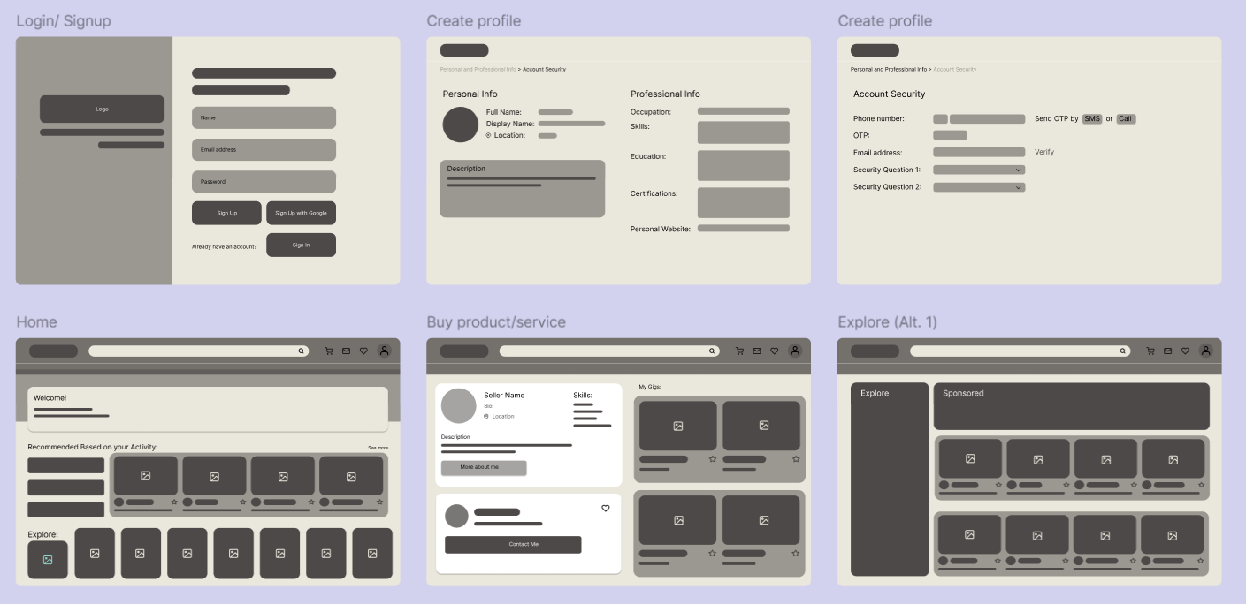
Refined Lo-Fi (Link)

Slide 17
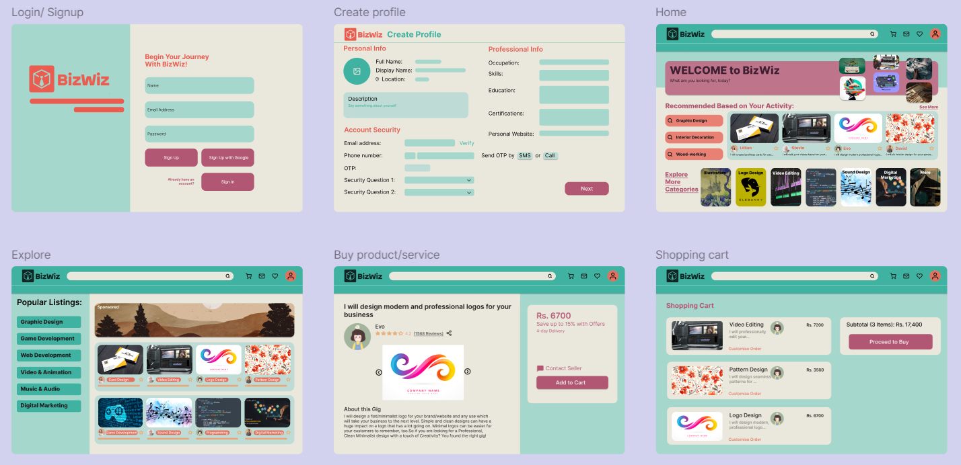
Hi-Fi Prototype (Link)

Slide 18
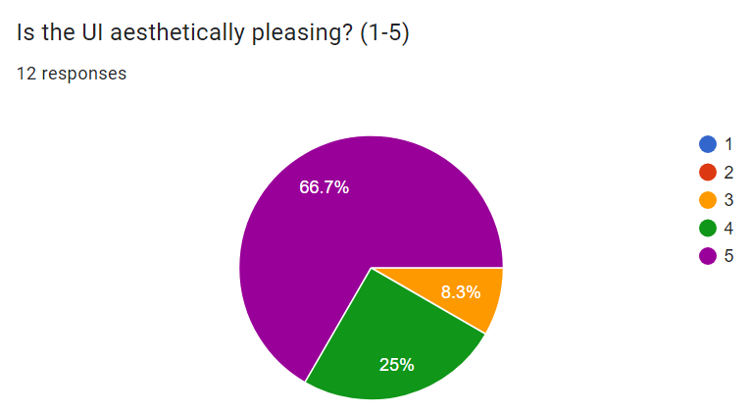
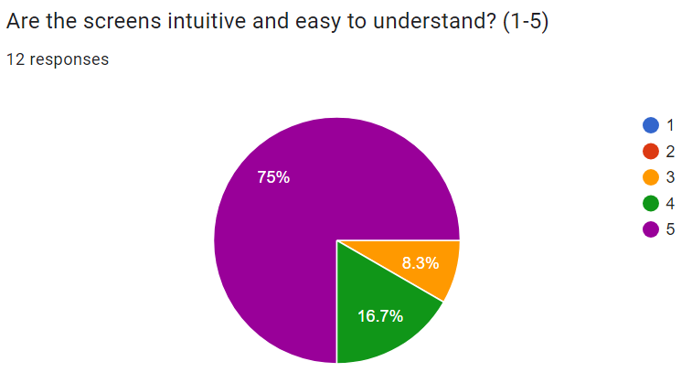
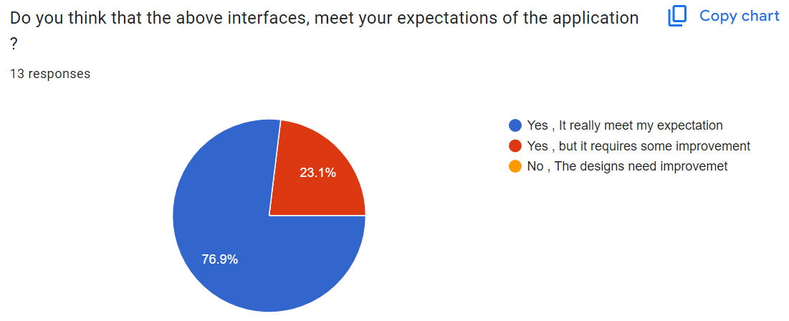
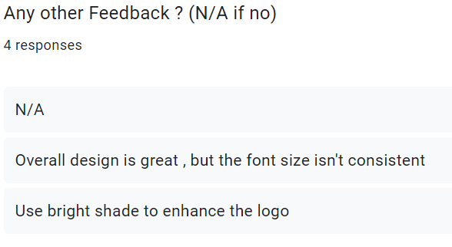
User Feedback (Link)

Slide 19
Synopsis of Feedback
Majority of users were happy with the design of our application and believed that it met their expectations. Users were mostly satisfied with UI and found it easy and intuitive to use. However, we did receive some negative feedback regarding the “Book Service” Screen. Aside from that, some users expressed concerns about the font size and certain design elements being inconsistent.

Slide 20
Learnings
and Reflections
Throughout this project, we learnt how to identify patterns and characteristics that distinguish good designs from bad ones. By analyzing various interfaces, we developed a keen eye for elements that contribute to user-friendly, visually appealing, and functional designs, as well as those that hinder user experience. This process deepened our understanding of what constitutes a well-designed interface, emphasizing the importance of clarity, consistency, and accessibility in creating effective designs.
Moreover, this project highlighted the significance of teamwork. By working together, we learned how to communicate effectively and coordinate tasks efficiently. This experience underscored that successful design is not just about individual creativity but also about using the collective effort of a team to produce good results.

Slide 21
Contributions
Ashutosh Prasad: Mind Maps, personas, task Flows, scenarios, final PPT, voiceover
Arun Kumar: Personas, google form for testing LoFi Designs
Bhumik: Requirement and feedback gathering
Dakshant Choudhary: Requirement gathering, problem understanding
Dhruv Tanwar: Requirement gathering, problem understanding, prototype evaluation
Evani Menon: Wireframes, alternate designs, refined Lo-Fi and Hi-Fi prototypes, voiceover

Slide 22
Thank You

